Slide 1
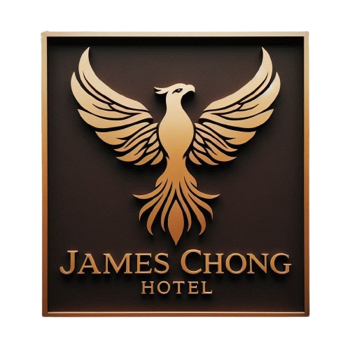
James Chong
Hotel Case Study
James Chong

Slide 2
Prompt
You are a senior data analyst on the Strategy and Operations team for the James Chong Hotel Company. The company has many hotel & resort in the world and the hotel aims to conduct fine-tuned marketing and operations in order to renovation and experience improvements.
The objective of James Chong Hotel Company this year is to categorize users based on the provided features. Based on the 2015, 2016, 2017 data attached, please present your findings and provide a set of recommendations for identify categorize. Feel free to make your own assumptions.

Slide 3
Agenda Slide
Column of Description
Analysis Approach/Framework
Feature Analysis
Result of Cluster
Key Recommendations Slide
Flow of Analysis Plan
Q&A

Slide 4
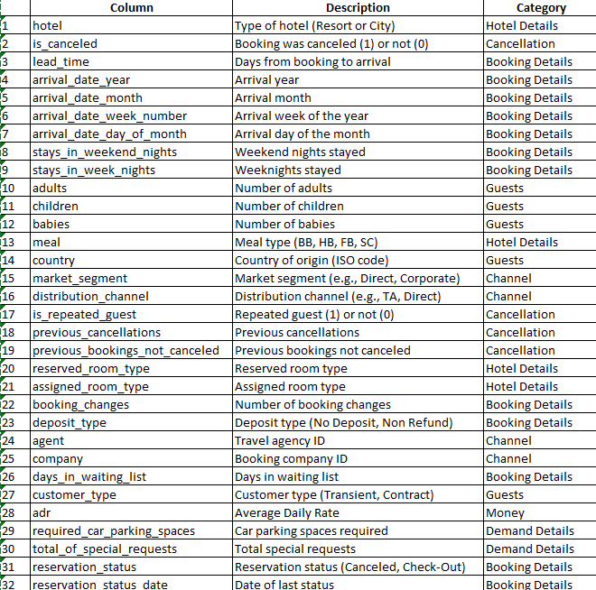

Slide 5

Analysis Approach/Framework
Objective : Category James Chong Hotel Company features users
Features
Users
=
User Portrait Analysis
K-Means Clustering Analysis
1.Loyal Guests (Budget Conscious)
2.Speculative Guests (High Risk )
3.High Spending Guests (Complex Need)

Slide 6
Feature Analysis

Slide 7
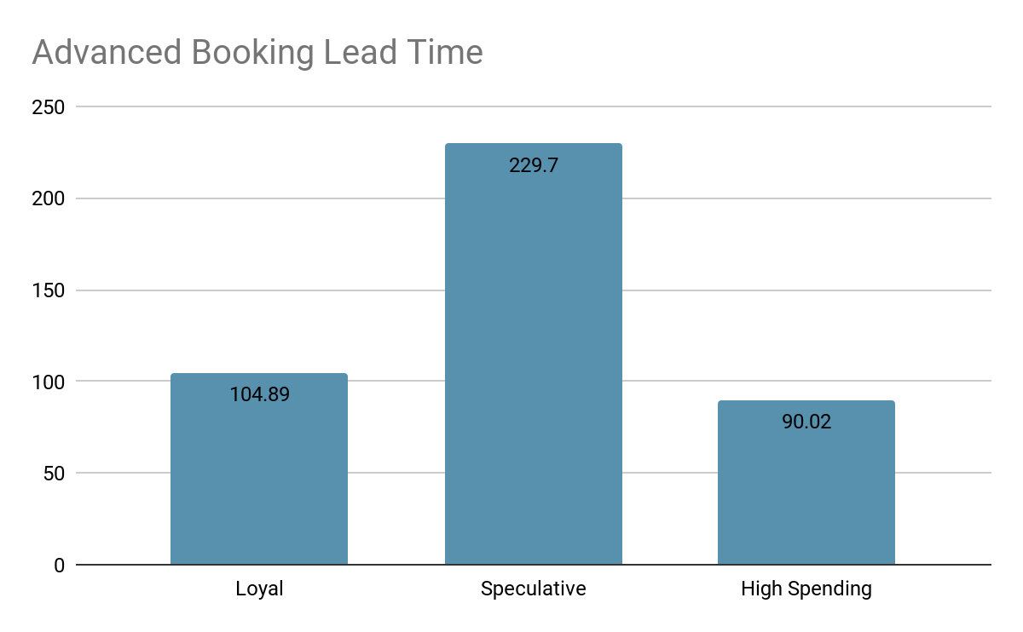
1.Advanced Booking Lead Time
Cluster Characteristics
Speculative has the highest advanced booking lead time at 229 days, followed by Loyal at 104 days, and High Spending at 90 days.
Feature | Loyal | Speculative | High Spending
Lead Time | 104.89days | 229.70days | 90.02days
Function: Identifies planners vs. last-minute bookers, aiding in marketing campaign timing.
Useful for tailoring the timing and urgency of marketing messages.

Slide 8
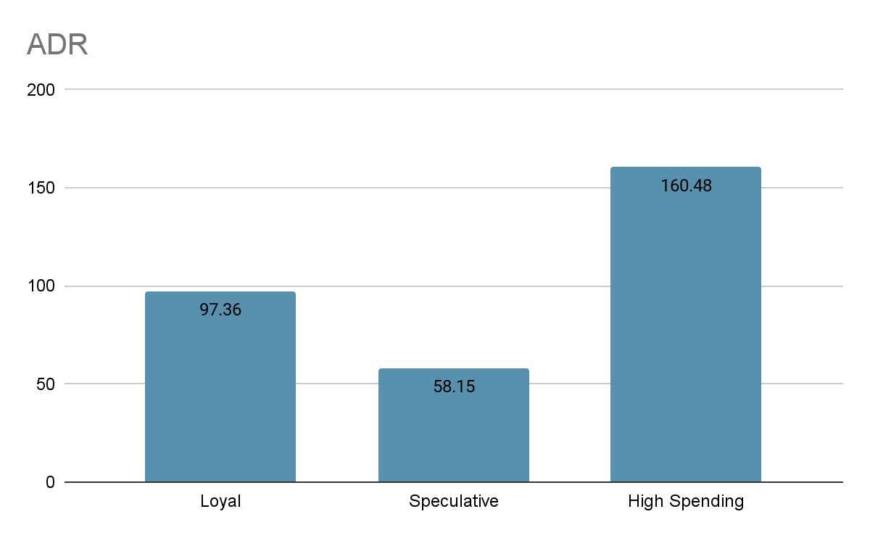
2.Average Dairy Rate Spending
Cluster Characteristics
High Spending has the highest average dairy rate spending at $160, followed by Loyal at $97, and Speculative at $58.
Feature | Loyal | Speculative | High Spending
Lead Time | 104.89days | 229.70days | 90.02days
ADR | $97.36 | $58.15 | $160.48
Function: Indicates guests' spending ability and patterns, useful for personalized offers and helps in providing discounts or premium services.

Slide 9
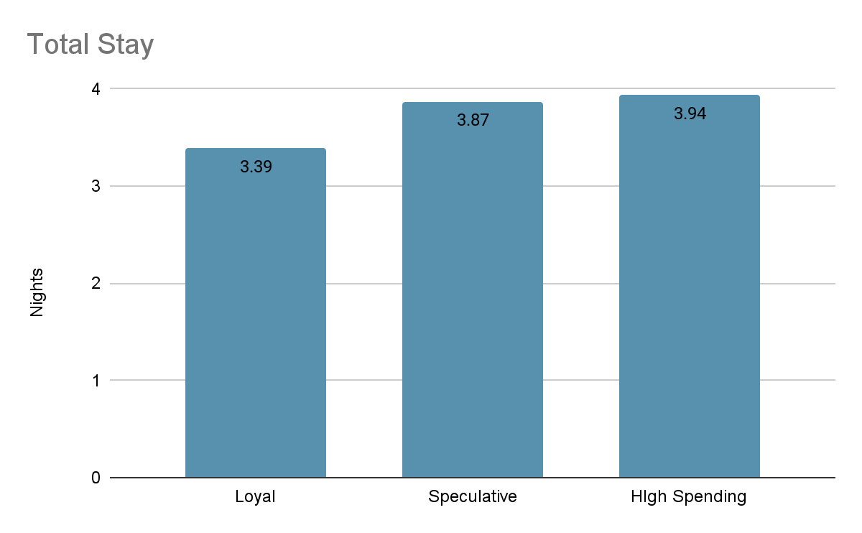
3.Total Stay
Cluster Characteristics
High Spending has the highest total stay at 3.94nights, followed by Speculative at 3.87nights, and Loyal at 3.39nights.
Feature | Loyal | Speculative | High Spending
Lead Time | 104.89days | 229.70days | 90.02days
ADR | $97.36 | $58.15 | $160.48
Total Stay | 3.39nights | 3.87nights | 3.94nights
Function: Reflects stay duration, aiding in personalized activity or service recommendations, longer stays often correlate with extensive service requirements.Valuable for segmenting guests by stay length and suggesting suitable amenities.

Slide 10
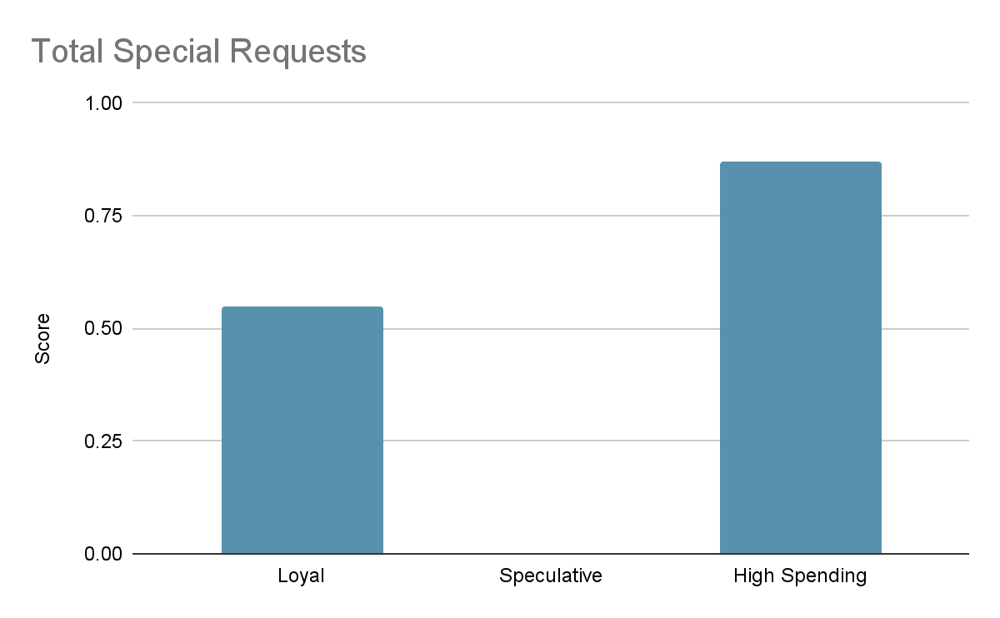
4.Total Of Special Requests
Cluster Characteristics
High Spending has the highest total of special requests at 0.87, followed by Loyal at 0.55, and Speculative at zero.
Feature | Loyal | Speculative | High Spending
Lead Time | 104.89days | 229.70days | 90.02days
ADR | $97.36 | $58.15 | $160.48
Total Stay | 3.39nights | 3.87nights | 3.94nights
Special Requests | 0.55 | 0.00 | 0.87
Function: Indicates guests' need for personalization and special accommodations, useful for improving customer service and satisfaction.Aids in identifying guests who prioritize personalized service.

Slide 11
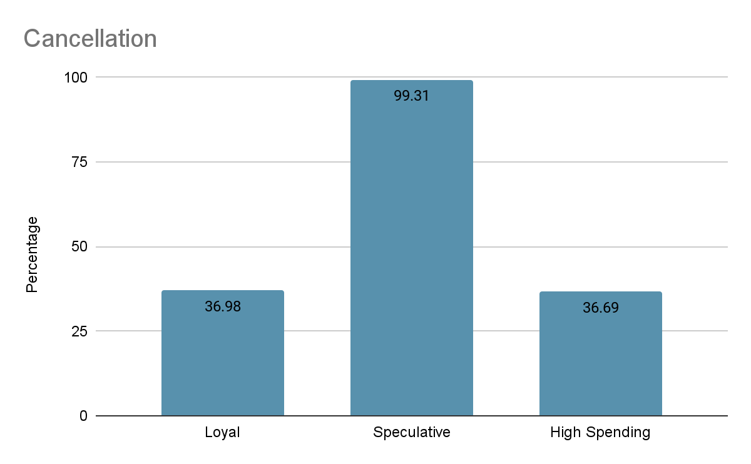
5.Cancellation
Cluster Characteristics
Speculative has the highest cancellation at 99.31% followed by Loyal at 36.98%, and High Spending at 36.69%.
Feature | Loyal | Speculative | High Spending
Lead Time | 104.89days | 229.70days | 90.02days
ADR | $97.36 | $58.15 | $160.48
Total Stay | 3.39nights | 3.87nights | 3.94nights
Special Requests | 0.55 | 0.00 | 0.87
Cancellation | 36.98% | 99.31% | 36.69%
Function: Indicates booking cancellations, valuable for assessing guest reliability and risk management.

Slide 12
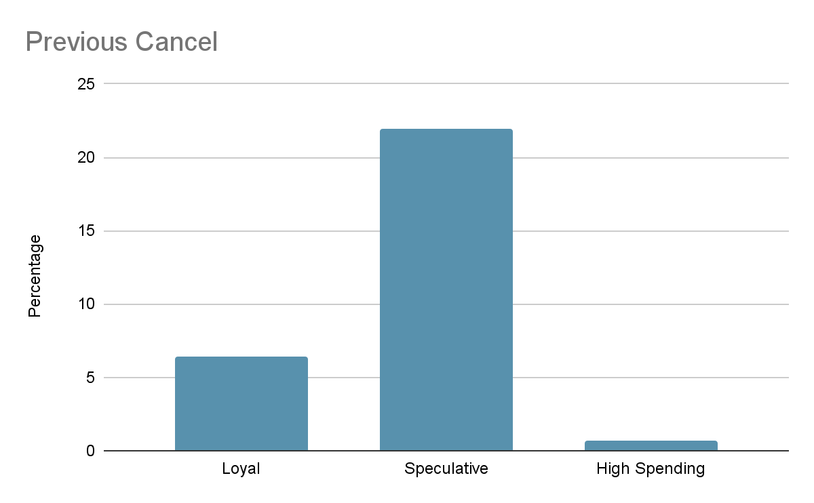
6.Previous Cancellation
Cluster Characteristics
Speculative has the highest previous cancellation at 21.98% followed by Loyal at 6.46%, and High Spending at 0.67%.
Feature | Loyal | Speculative | High Spending
Lead Time | 104.89days | 229.70days | 90.02days
ADR | $97.36 | $58.15 | $160.48
Total Stay | 3.39nights | 3.87nights | 3.94nights
Special Requests | 0.55 | 0.00 | 0.87
Cancellation | 36.98% | 99.31% | 36.69%
Previous Cancelled | 6.46% | 21.98% | 0.67%
Function: Shows guests' cancellation habits, aiding in risk management and tailored cancellation policies.Useful for managing booking risks.

Slide 13
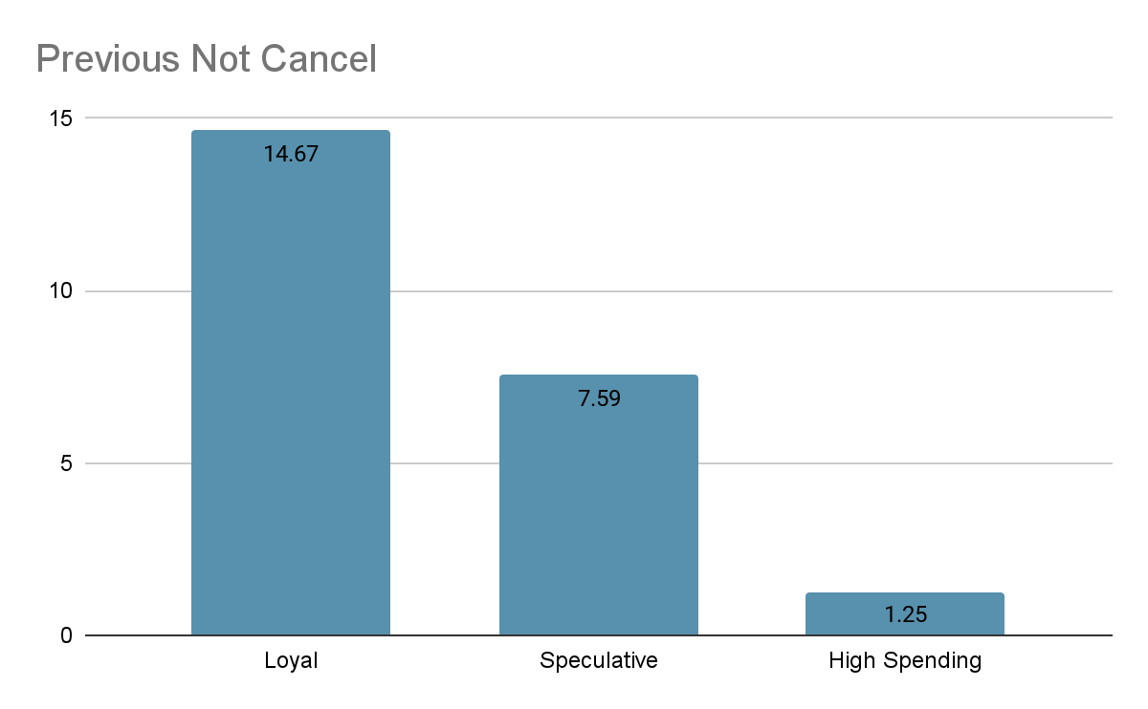
7.Previous Not Cancellation
Cluster Characteristics
Loyal has the highest previous not cancellation at 14.67% followed by Speculative at 7.59%, and High Spending at 1.25%.
Feature | Loyal | Speculative | High Spending
Lead Time | 104.89days | 229.70days | 90.02days
ADR | $97.36 | $58.15 | $160.48
Total Stay | 3.39nights | 3.87nights | 3.94nights
Special Requests | 0.55 | 0.00 | 0.87
Cancellation | 36.98% | 99.31% | 36.69%
Previous Cancel | 6.46% | 21.98% | 0.67%
Previous Not Cancel | 14.67% | 7.59% | 1.25%
Function: Indicates guests' booking reliability, useful for trust-building, incentive programs and rewarding dependable guests.

Slide 14
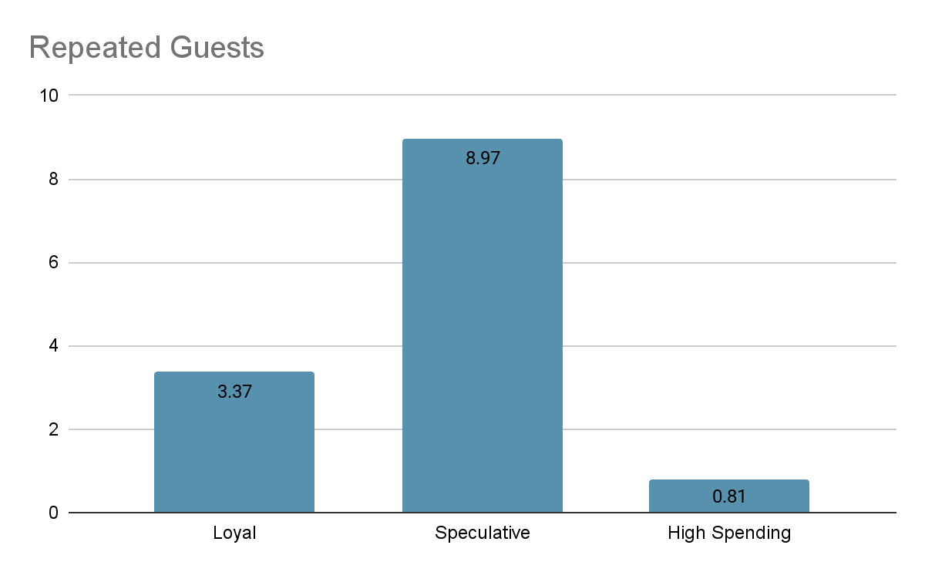
8.Repeated Guests
Cluster Characteristics
Speculative has the highest repeated guest at 8.97% followed by Loyal at 3.37%, and High Spending at 0.81%.
Feature | Loyal | Speculative | High Spending
Lead Time | 104.89days | 229.70days | 90.02days
ADR | $97.36 | $58.15 | $160.48
Total Stay | 3.39nights | 3.87nights | 3.94nights
Special Requests | 0.55 | 0.00 | 0.87
Cancellation | 36.98% | 99.31% | 36.69%
Previous Cancelled | 6.46% | 21.98% | 0.67%
Previous Not Cancel | 14.67% | 7.59% | 1.25%
Repeated Guests | 3.37% | 8.97% | 0.81%
Function: Identifies loyal guests with multiple bookings, essential for loyalty and retention strategies.High impact on creating personalized loyalty and retention marketing.

Slide 15
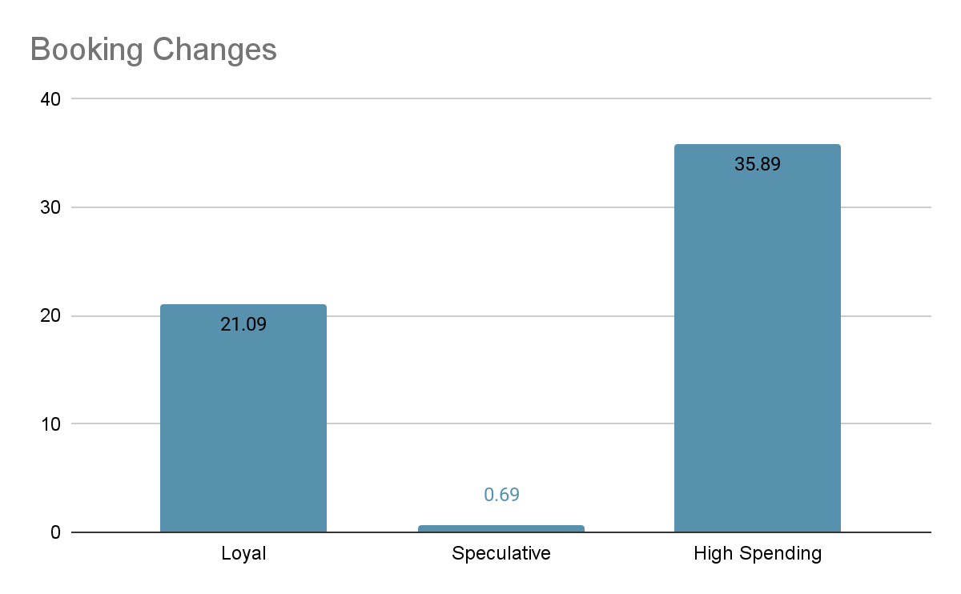
9.Booking Changes
Cluster Characteristics
High Spending has the highest booking changes at 35.89% followed by Loyal at 21.09%, and High Spending at 0.69%.
Feature | Loyal | Speculative | High Spending
Lead Time | 104.89days | 229.70days | 90.02days
ADR | $97.36 | $58.15 | $160.48
Total Stay | 3.39nights | 3.87nights | 3.94nights
Special Requests | 0.55 | 0.00 | 0.87
Cancellation | 36.98% | 99.31% | 36.69%
Previous Cancelled | 6.46% | 21.98% | 0.67%
Previous Not Cancel | 14.67% | 7.59% | 1.25%
Repeated Guests | 3.37% | 8.97% | 0.81%
Booking Changes | 21.09% | 0.69% | 35.89%
Function: Shows booking modifications, useful for assessing guest flexibility and needs.Aids in identifying guests who value flexible booking options.

Slide 16
Result of Cluster

Slide 17
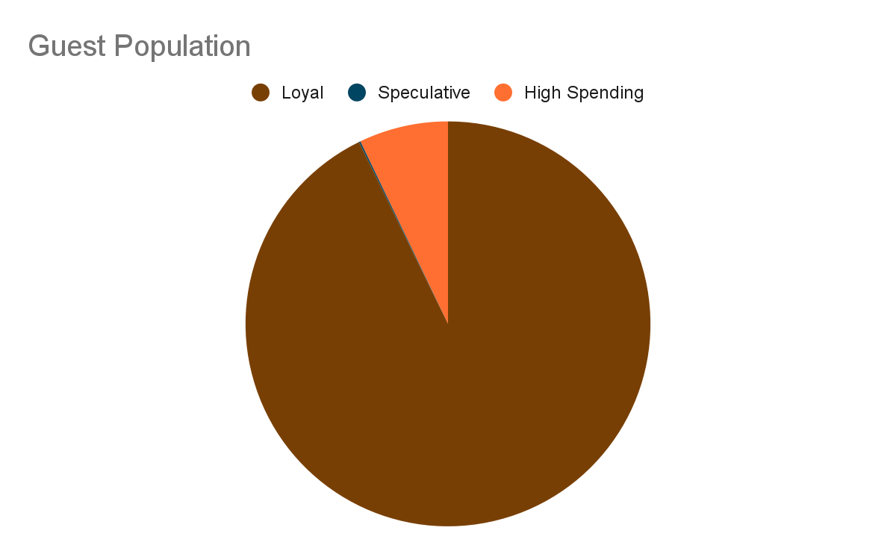
Result of Cluster
Cluster Characteristics
Feature | Loyal | Speculative | High Spending
Lead Time | 104.89days | 229.70days | 90.02days
ADR | $97.36 | $58.15 | $160.48
Total Stay | 3.39nights | 3.87nights | 3.94nights
Special Requests | 0.55 | 0.00 | 0.87
Cancellation | 36.98% | 99.31% | 36.69%
Previous Cancelled | 6.46% | 21.98% | 0.67%
Previous Not Cancel | 14.67% | 7.59% | 1.25%
Repeated Guests | 3.37% | 8.97% | 0.81%
Booking Changes | 21.09% | 0.69% | 35.89%
Population | 92.75% | 0.12% | 7.13%
Loyal-92.75%
Budget and Price Conscious
Exp: Family
Speculative -0.12%
High Risk Cancellation
Exp: Business
High Spending -7.13%
High & Complex requests
Exp: VVIP

Slide 18
So What?

Slide 19
Key Recommendations Slide

Slide 20
Key Recommendations- Loyal Guests(Family), Cluster 0
Marketing Strategy
1.Focus on Loyalty Programs and Offer Discounts for Repeated Bookings:
Example: Introduce a tiered loyalty program where guests earn points for each stay. Points can be redeemed for discounts, free nights, or special perks like free breakfast or late check-out.
Challenges: Ensuring the program is attractive enough to retain guests while maintaining profitability. Tracking and managing points efficiently.
2.Create Personalized Offers to Retain These Guests:
Example: Use past booking data to send personalized emails with exclusive offers, such as a special discount on their favorite room type or complimentary services like airport transfers.
Challenges: Maintaining data privacy and security, ensuring personalized offers are truly relevant and valued by the guests.
3.Highlight Value-for-Money Deals and Consistent Quality of Service:
Example: Promote packages that bundle services at a discount, such as weekend getaways with included meals and activities. Emphasize customer reviews and testimonials that highlight consistent quality.
Challenges: Competing with online travel agencies that also offer bundled deals. Ensuring that the perceived value matches the actual guest experience.

Slide 21
Key Recommendations- Loyal Guests(Family),Cluster 0
Operational Strategy
1.Ensure Consistent Quality to Maintain Loyalty and Satisfaction:
Example: Implement standard operating procedures (SOPs) for all guest-facing services to ensure a uniform experience. Conduct regular training sessions for staff on service quality.
Challenges: Maintaining consistency across different locations and shifts. Ensuring all staff adhere to SOPs.
2.Optimize Operations to Cater to Budget-Conscious Travelers, Ensuring Essential Amenities are Provided:
Example: Offer essential amenities like free Wi-Fi, complimentary breakfast, and convenient check-in/check-out processes. Optimize room cleaning and maintenance schedules to reduce costs without compromising quality.
Challenges: Balancing cost-cutting measures with maintaining quality. Handling peak times efficiently without reducing service levels.

Slide 22
Key Recommendations- High Spending Guests(VVIP),Cluster 2
Marketing Strategy
1.Offer Premium Services, Personalized Packages, and Special Requests Handling:
Example: Provide concierge services that offer personalized itineraries, exclusive access to events, and custom dining experiences. Create packages that cater to special occasions like anniversaries or business conferences.
Challenges: Ensuring the delivery of high-quality personalized services. Managing the cost of providing premium services.
2.Focus on Upselling and Cross-Selling Higher-End Amenities:
Example: Train staff to identify opportunities to upsell room upgrades, spa services, or exclusive dining options. Use CRM data to recommend services based on past preferences.
Challenges: Avoiding the perception of being too pushy. Ensuring that upselling efforts enhance rather than detract from the guest experience.
3.Create Targeted Marketing Campaigns that Highlight Luxury Experiences and Family-Friendly Options:
Example: Use targeted digital marketing campaigns that showcase luxury experiences, such as private tours, gourmet dining, and high-end wellness retreats. Highlight family-friendly amenities like kids’ clubs and family suites.
Challenges: Identifying and reaching the right audience segments. Measuring the effectiveness of targeted campaigns.

Slide 23
Key Recommendations- High Spending Guests(VVIP),Cluster 2
Operational Strategy
Ensure High-Quality, Responsive Service to Meet Complex Needs and Enhance Guest Satisfaction:
Example: Implement a guest satisfaction tracking system that collects real-time feedback and allows staff to respond quickly to issues. Offer personalized check-in experiences.
Challenges: Training staff to handle complex needs efficiently. Maintaining high service levels during peak times.
Train Staff to Handle Special Requests Efficiently and Provide Personalized Attention to this Segment:
Example: Conduct specialized training programs for staff on handling VIP guests and managing special requests. Use technology to track and fulfill special requests seamlessly.
Challenges: Keeping staff motivated and well-trained. Balancing personalized attention with overall operational efficiency.

Slide 24
Key Recommendations- Speculative Guests(Business)
Marketing Strategy
Implement Stricter Cancellation Policies or Require Non-Refundable Deposits:
Example: Introduce a tiered cancellation policy where guests receive partial refunds based on the timing of the cancellation (e.g., 50% refund if canceled within 7 days of booking).
Challenges: Potential guest dissatisfaction with stricter policies. Communicating policy changes clearly to avoid disputes.
Encourage Commitment Through Special Offers that Incentivize Keeping Bookings:
Example: Offer discounts or perks (e.g., free breakfast, room upgrades) for bookings that are kept without modifications or cancellations.
Challenges: Balancing incentives to ensure they are attractive yet financially viable. Monitoring and managing these offers effectively.
Consider Marketing Strategies that Reduce Speculative Booking Behavior:
Example: Use targeted advertising to reach guests who have a history of reliable bookings. Offer flexible booking options with lower discounts for those who might need to change plans.
Challenges: Identifying and reaching the right audience. Managing the financial impact of offering more flexible options.

Slide 25
Key Recommendations- Speculative Guests(Business)
Operational Strategy
Closely Monitor and Manage Booking Cancellations to Minimize Revenue Loss:
Example: Use predictive analytics to identify high-risk bookings and proactively manage these by offering incentives to keep the booking or by double-booking rooms with low cancellation risk.
Challenges: Accurate prediction of cancellations. Handling the logistics of managing overbooked situations.
Implement Systems to Quickly Rebook Canceled Slots to Maximize Occupancy:
Example: Use real-time inventory management systems to immediately make canceled rooms available to other potential guests. Partner with last-minute booking platforms.
Challenges: Ensuring systems are robust and integrated with all sales channels. Managing guest expectations and experiences for last-minute bookings.

Slide 26
Flow of Analysis Plan

Slide 27
### Step 1: Data Loading and Initial Exploration
- Load the data from the provided CSV file and review the first few rows and summary statistics.
- Load the column descriptions from the Excel file to understand the meaning of each column.
### Step 2: Data Cleaning and Preprocessing
- Check for missing values and decide on the handling strategy (e.g., fill in or remove).
- Identify and handle any obvious errors or outliers.
- Convert data types as necessary (e.g., convert date strings to date objects).
### Step 3: Exploratory Data Analysis (EDA)
- Conduct EDA to understand the distributions and relationships of various features.
- Use histograms, scatter plots, and box plots to visualize important characteristics.
### Step 4: Feature Selection and Engineering
- Decide on features for clustering based on EDA insights and column descriptions.
- Create new features if necessary (e.g., derive length of stay from check-in and check-out dates).
### Step 5: Data Normalization
- Normalize the data to ensure all features contribute equally to the k-means distance calculations.
### Step 6: Choosing the Number of Clusters
- Use the elbow method or silhouette analysis to determine an appropriate number of clusters.
### Step 7: Clustering with K-Means
- Apply k-means clustering to the normalized data.
- Analyze cluster characteristics to understand different user profiles.
### Step 8: Evaluation and Interpretation
- Evaluate the clustering results using appropriate metrics.
- Interpret the clusters in terms of marketing and operational strategies.
### Step 9: Visualizing Results
- Visualize the clustering results and feature distributions within clusters.
### Step 10: Reporting and Recommendations
- Compile findings into a report with visualizations and actionable recommendations.

Slide 28
Missing Values Analysis
Here are the columns with missing values and their counts:
Children: 4 missing values.
Country: 488 missing values.
Agent: 16,340 missing values.
Company: 112,593 missing values.
Proposed Handling Strategies
Children: Given the very few missing values, we can fill these with the mode (most frequent value) of the column.
Country: Missing values could be labeled as 'Unknown' since this would not disrupt the data's integrity.
Agent: A large number of missing values suggest that these bookings might not have been made through an agent. We could fill these with a special identifier like 'None' or '0'.
Company: Similar to 'Agent', the high count of missing values implies many bookings weren't associated with a company. We could use 'None' or '0' to fill these gaps.

Slide 29
Outliers Analysis
Here are the summary statistics for the numerical features where outliers were detected:
Lead Time: Mean lead time is about 100 days, but there's a wide range, extending up to 737 days.
ADR (Average Daily Rate): Averages around 112 with a maximum outlier value of 5400, which seems unusually high and might be an error.
Adults: While the average is around 1.59, there are outliers with bookings for up to 55 adults, which could be erroneous or group bookings.
Children and Babies: Some bookings include up to 10 children or babies, which might be plausible for large family bookings but should be verified.
Handling Outliers
ADR: Rates higher than a certain threshold (e.g., 1000) might be considered errors or special cases and could be capped or investigated further.
Adults: Bookings with unusually high numbers of adults (e.g., more than 10) could be errors unless confirmed as group bookings.
Children and Babies: Since the numbers aren't extraordinarily high, these might not need adjustment unless they are inconsistent with other booking details.

Slide 30
Q & A

Slide 31
Thank You

